Slide 1

Global Retail Chain Customer Segmentation
Driving 20% Revenue Growth Potential Through Data-Driven Customer Segmentation
Used Python clustering to identify high-value customer cohorts and built actionable Looker Studio dashboards for targeted marketing

Slide 2
1. Project Snapshot
Category
Details
Role
Business Intelligence Analyst (Business Intelligence Course Project)
Tools Used
Python (Pandas, NumPy, Scikit-learn, matplotlib), Looker Studio
Key Techniques
RFM Analysis, K-Means Clustering, Data Visualization
Core Impact
Identified 44% of customers driving 85% revenue; recommended personalized promotions and expansion regions

Slide 3
2. Business Problem
🎯 Blind Marketing:
📉 Revenue Leakage:
📊 Market Blindness:
One-size-fits-all promotions
High-value customers not receiving VIP treatment
No visibility on growing and underperforming markets

Slide 4

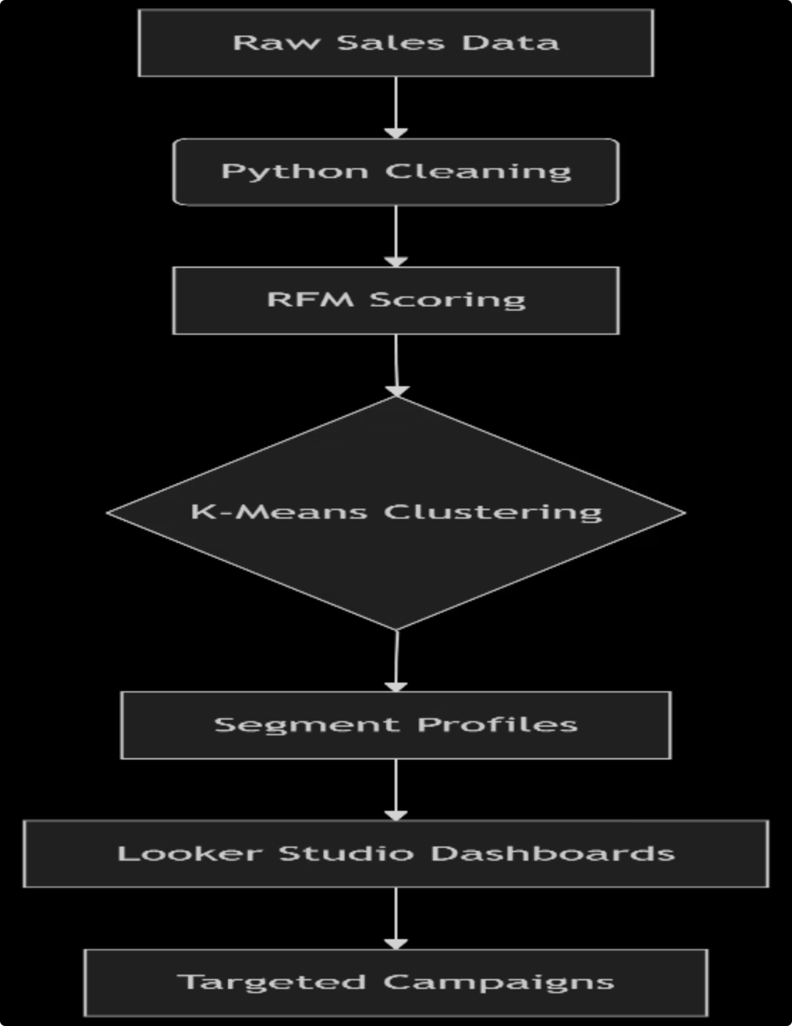
3. Solution
3.1 Workflow Architecture Diagram

Slide 5
3.2 Key Steps:
Phase
Action
Technical Approach
Data Preparation
Cleaned 2 years of customer data
Pandas: groupby(), one-hot encoding
Feature Engineering
Performed feature engineering to create new columns including but not limited to RFM (Recency, Frequency, Monetary) scores, Total_Spend = Sum(MNTs), and Total_purchases.
Calculated purchase gaps, visit counts, spend averages
Clustering
Identified two distinct customer segments guided by KMeans clustering
Scikit-learn: KMeans(n_clusters=2), elbow method
Insight Generation
Profiled "Champions" (44% of customers, 85% revenue)
Comparative analysis: df['Segment'].describe()
Visualization
Built executive-friendly dashboards
Looker Studio: RFM quadrant + cohort behaviour trends

Slide 6
4. Key Insights & Business Impact
4.1 Segment Breakdown:
Segment
% Customers
% Revenue
Behaviour
Strategy
Champions
44%
85%
Recent, frequent, high spend
VIP loyalty programs
Potential Loyalists
20%
36%
High frequency, medium spend
Personalization experiments
At-Risk
8%
20%
Declining recency
Win-back campaigns

Slide 7
4.2 Strategic Recommendations:
1
2
3
VIP Treatment:
Personalized Coupons:
Win-Back Kit:
Target High LTV (Smaller family size and higher income) customers by premium offers.
Personalized offers for high-margin categories in underperforming markets such as Spain.
Reactivate “High_risk” segment via win-back campaigns to boost monthly revenue by at least 20%.

Slide 8







Thank You!
Let's Connect
Farrukh Nadeem
Email
Business Intelligence Analyst
fnadeem485@gmail.com
Contact No.
LinkedIn
+92 332 0378871
Farrukh Nadeem
GitHub
Looker Studio
farrukh-nadeem
Customer Personality Analysis

